Slide 1
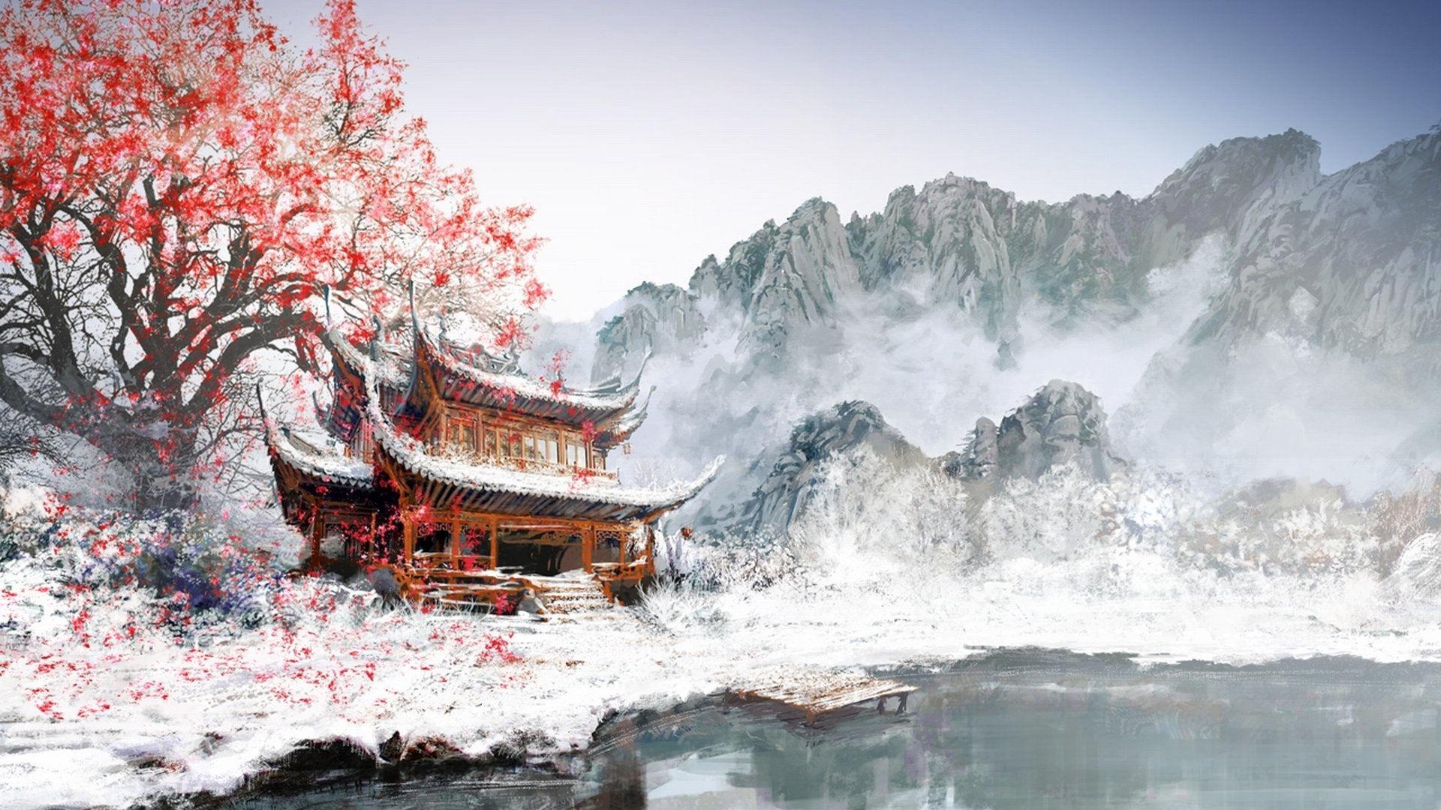
China & History
中国与历史
Made by Muhammad Arsalan 穆罕默德·阿尔萨兰制造
Grade 11-O

Slide 2
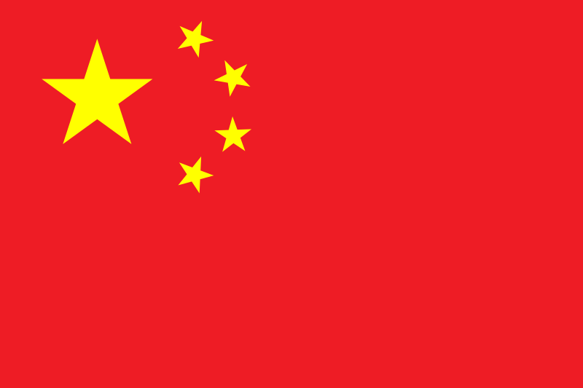
Flag
旗帜
The flag of China, officially the National Flag of the People's Republic of China, also known as the Five-star Red Flag, is a Chinese red field with five golden stars charged at the canton. The design features one large star, with four smaller stars in an arc set off towards the fly.

Slide 3
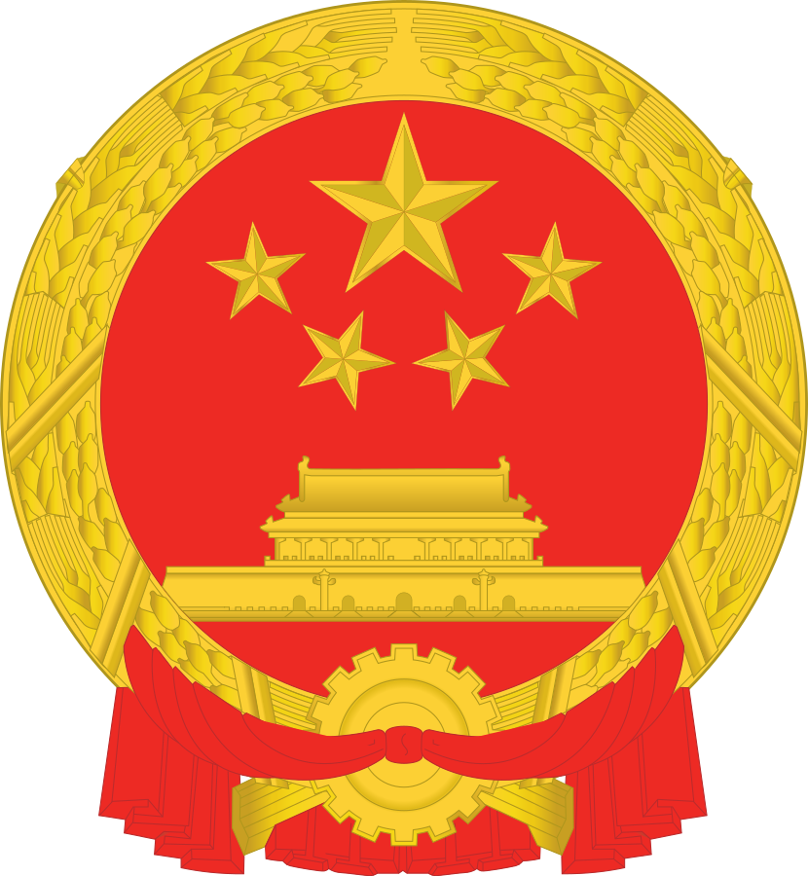
Emblem
徽
The National Emblem of the People's Republic of China contains in a red circle a representation of Tiananmen Gate. Above this representation are the five stars found on the national flag.

Slide 4
Brief
简要信息
China, officially the People's Republic of China, is a country in East Asia. It is the world's most populous country, with a population of more than 14 billion. China spans five geographical time zones and borders 14 different countries, the second most of any country in the world after Russia. Covering an area of approximately 96 million square kilometers (3,700,000 sq mi), it is the world's third or fourth largest country. The country consists of 23 provinces, four municipalities, five autonomous regions, and two Special Administrative Regions (Hong Kong and Macau). The national capital is Beijing.

Slide 5
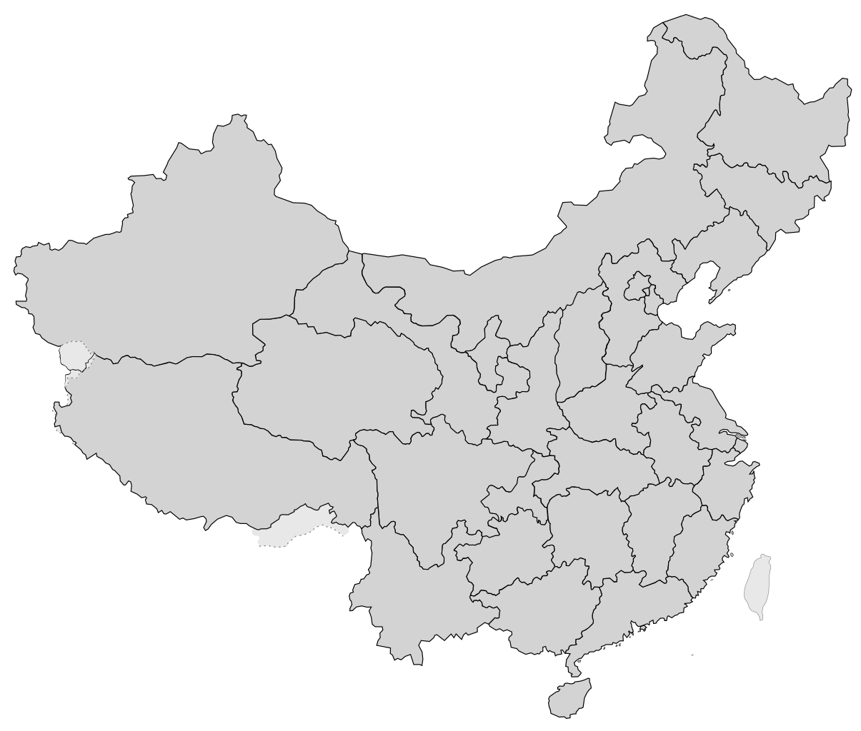
MAP
地图
Land area: 3,600,927 sq mi (9,326,411 sq km)
Total area: 3,705,407 sq mi (9,596,960 sq km)

Slide 6
Language
语
Chinese is a group of languages that form the Sinitic branch of the Sino-Tibetan languages, spoken by the ethnic Han Chinese majority and many minority ethnic groups in Greater China. About 1.3 billion people (or approximately 16% of the world's population) speak a variety of Chinese as their first language.
这个演示文稿太棒了

Slide 7
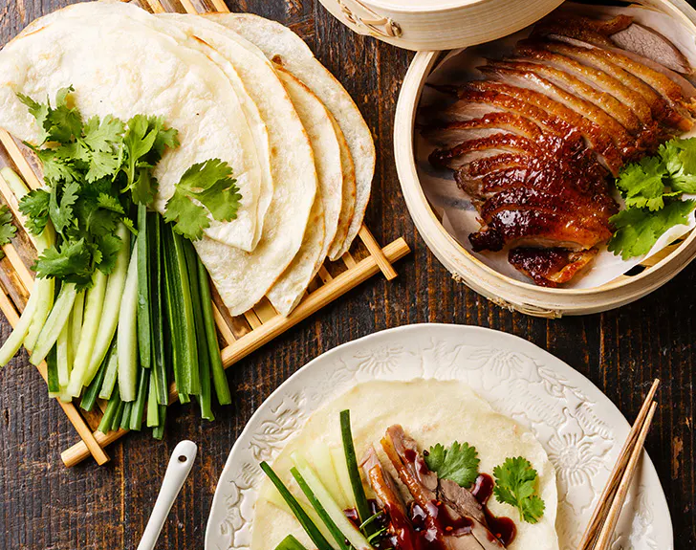
Food
Some of the greatest and most well known dishes as of today.

Slide 8
Food
食物
Chinese cuisine is an important part of Chinese culture and includes cuisines originating from China. Because of the Chinese diaspora and historical power of the country, Chinese cuisine has influenced many other cuisines in Asia and beyond, with modifications made to cater to local palates. Chinese food staples such as rice, soy sauce, noodles, tea, chili oil, and tofu, and utensils such as chopsticks and the wok, can now be found worldwide.
The preferences for seasoning and cooking techniques of Chinese provinces depend on differences in historical background and ethnic groups. Geographic features including mountains, rivers, forests, and deserts also have a strong effect on the local available ingredients, considering that the climate of China varies from tropical in the south to subarctic in the northeast. Imperial royal and noble preference also plays a role in the change of Chinese cuisine. Because of imperial expansion and trading, ingredients and cooking techniques from other cultures have been integrated into Chinese cuisines over time.

Slide 9
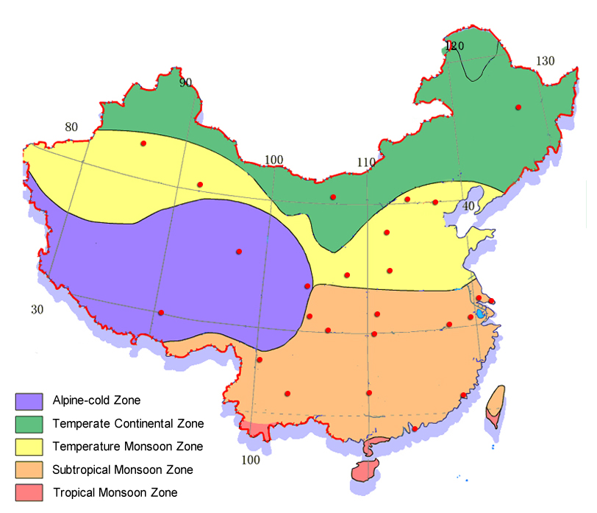
Climate
气候
Always on the top!

Slide 10
Climate
气候
China's climate varies from bitter cold in winter to unbearable heat in summer. The Yangtze River serves as China's official dividing line between north and south. Given the size and varied landscape of the country, there is no one time in the year when Chinese weather is ideal. Of course, the warmest areas in winter are to be found in the South and Southwest, such as Sichuan, Banna in Yunnan, and Hainan Island. In summer the coolest spots are in the far northeast.

Slide 11
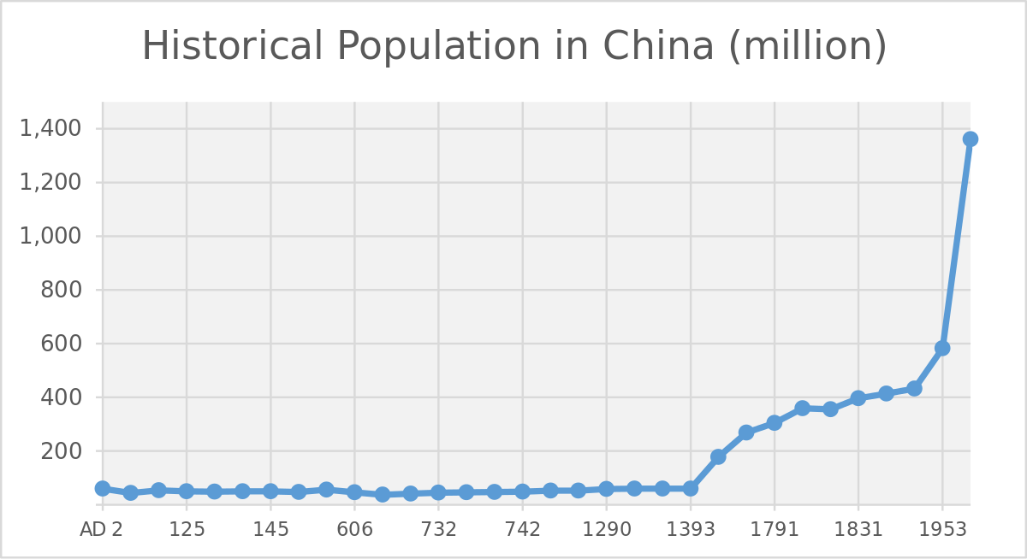
Population
人口
The population on China is on world’s no. one and is one of the main reasons that China is trying to reduce reproduction of babies in the Country.

Slide 12
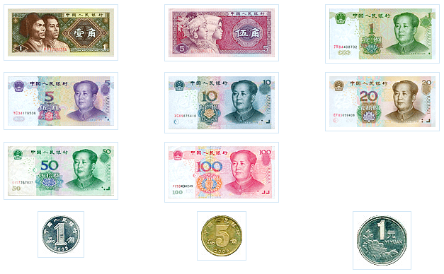
Currency
货币
The Renminbi (RMB)

Slide 13
Currency
货币
The renminbi is the official currency of the People's Republic of China and one of the world's reserve currencies, ranking as the eighth most traded currency in the world as of April 2019.
The yuan (Chinese: 元; pinyin: yuán) is the basic unit of the renminbi, but the word is also used to refer to the Chinese currency generally, especially in international contexts. One yuan divides into 10 jiao (Chinese: 角; pinyin: jiǎo), and a jiao in turn divides into 10 fen (Chinese: 分; pinyin: fēn). The renminbi is issued by the People's Bank of China, the monetary authority of China.

Slide 14
Thank You!
非常感谢你
Come visit China!来中国看看吧！ And also https://jis-grade11.web.app/

